Slide 1
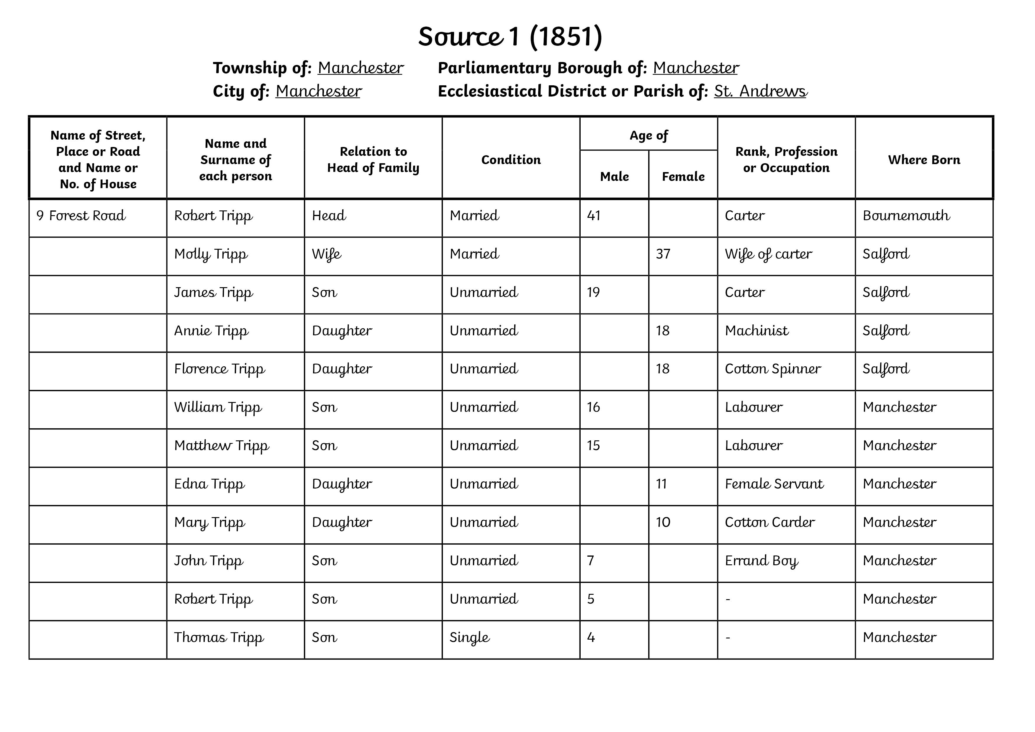
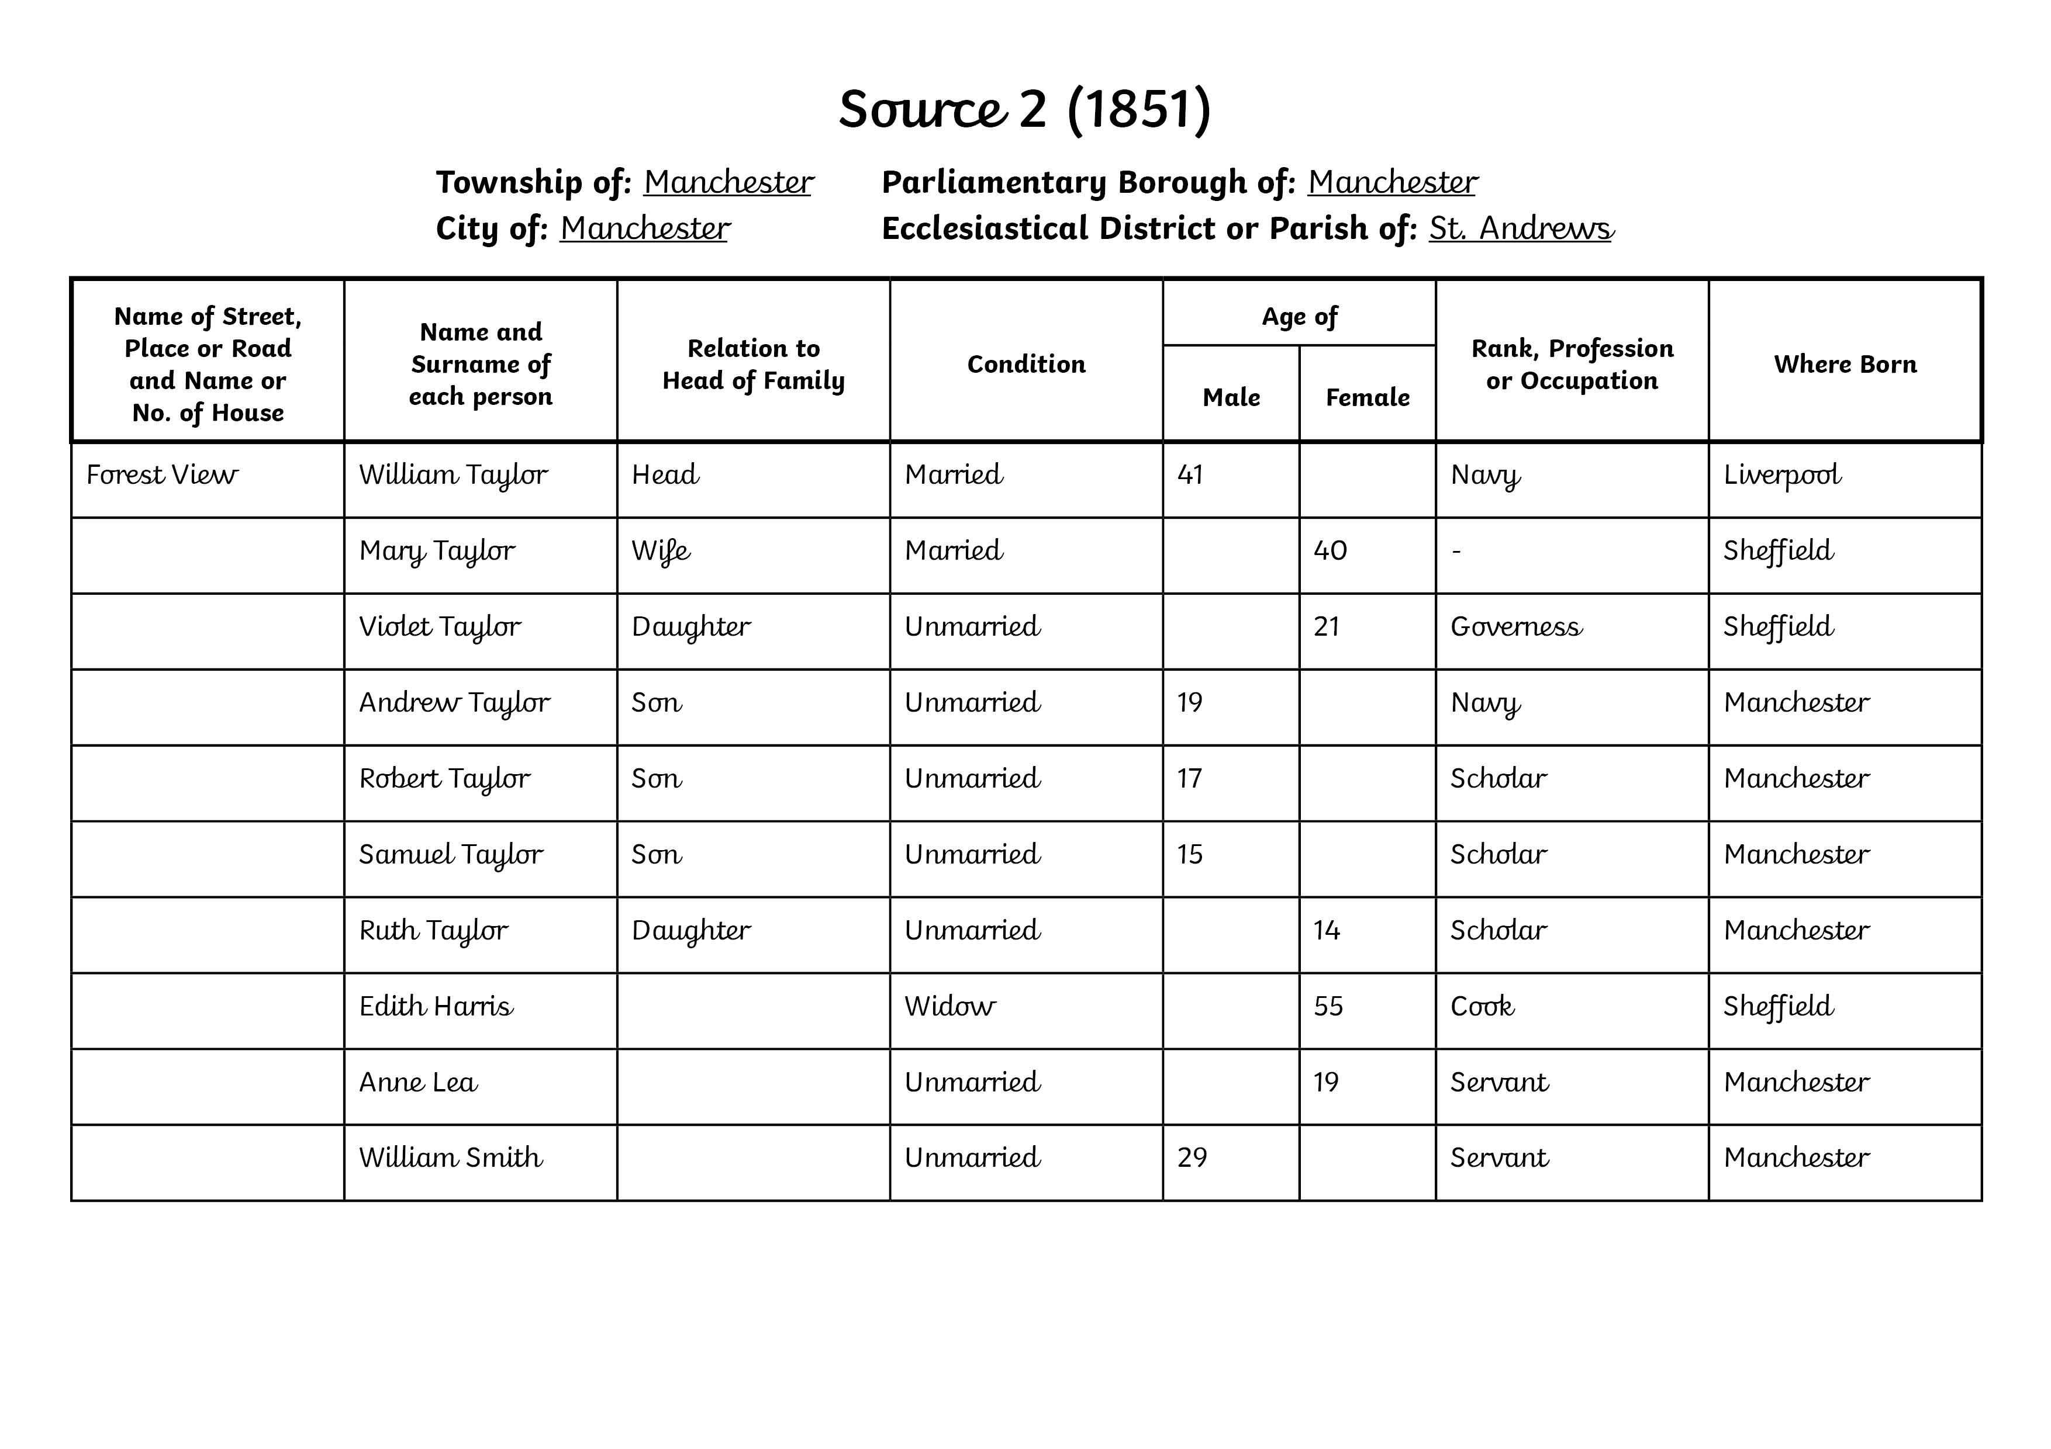
Activity 1: Who Lived Here?
Look at Source 1.
Use the information to answer the following questions:
Who is the head of this family?
What was their occupation?
How many children did they have?
How many people lived in the house altogether?
Source Material
Now look at Source 2.
Can you answer similar questions using this census return?
How are these families the same? How are they different?
Was one family richer than the other? How can you tell?
Source 1
Source 2

